Slide 1
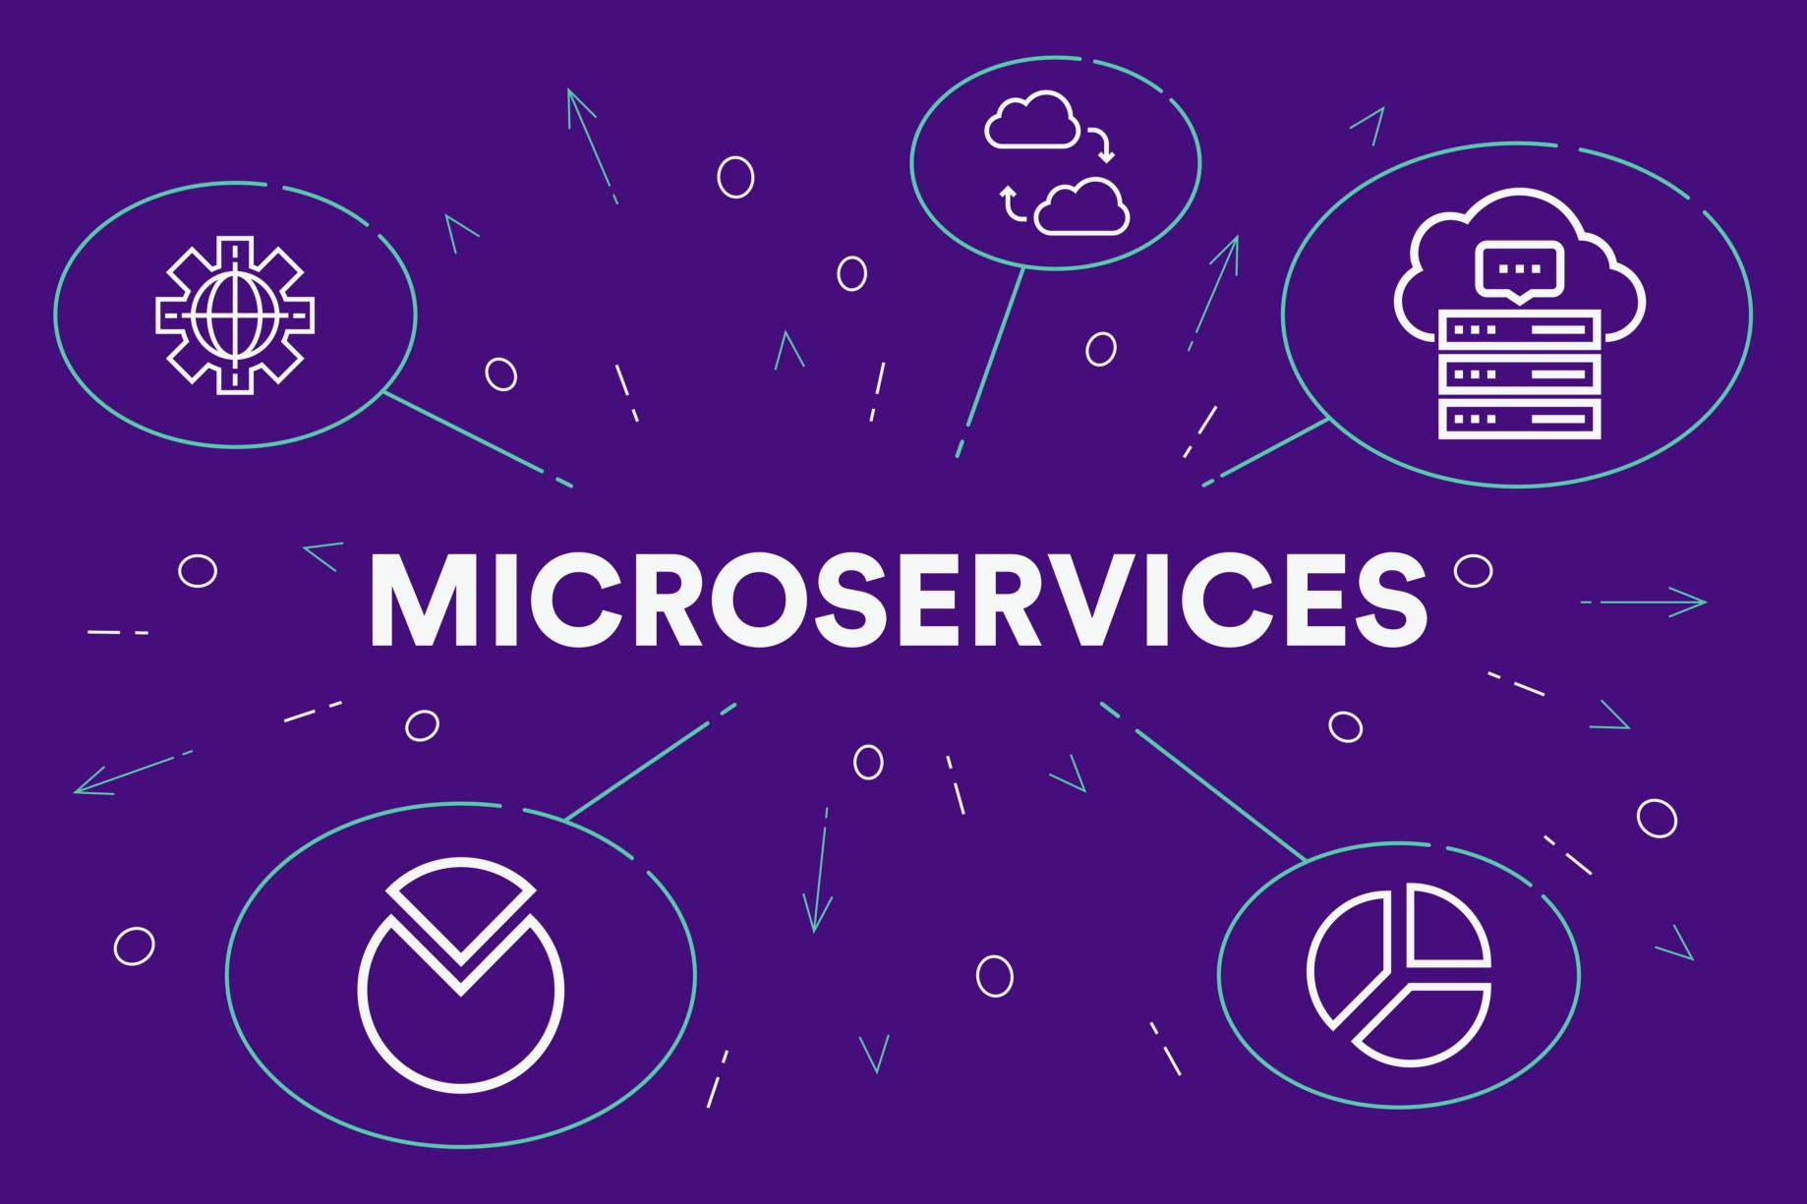
Presented by
Sireesha

Slide 2
Agenda:
Introduction to Microservices
Principles of Microservices
Difference Between Monolithic , Service-Oriented and Microservices
How does Microservice Architecture work
Features of Microservices
Advantages of Microservices
Challenges of Microservices
Microservice Frameworks for Java
Microservice development Life Cycle

Slide 3
Introduction to Microservices:
Microservice is a small unit that has only one responsibility or single logic which solve a specific problem.
Microservices are the evolution of Service-Oriented Architecture(SOA).
Microservices are small and independent services that work together.
A style of engineering to build highly automated , independent and evolving software.
Each Microservice can be deployed independently.
A Microservice itself persist its own data or external state.
All Services don’t need to share the same technology stack , libraries or frameworks.

Slide 4
Service-Oriented Architecture:
Service :
A service is a self-contained function that represents a unit of functionality.
A service can exchange information from another service.
It is not dependent on the state of another service.
It uses a loosely coupled, message-based communication model to communicate with applications and other services.
SOA:
A service-oriented architecture (SOA) is an architectural pattern in computer software design in which application components provide services to other components via a communications protocol, typically over a network.

Slide 5
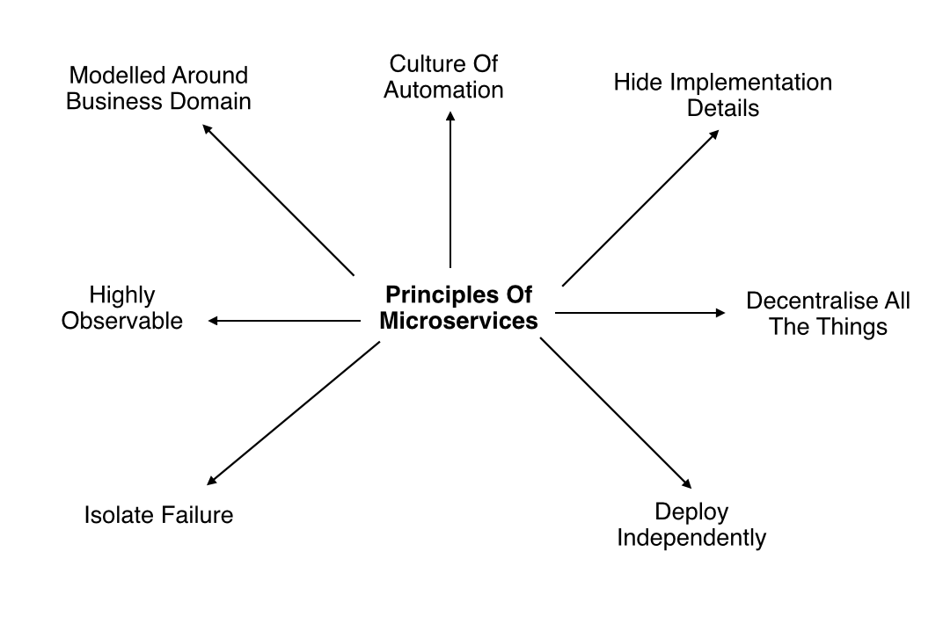
Principles of Microservices

Slide 6
Modelled around business domain: Separate System capability into different domains and each domain will focus on one thing and its associated logic.
Culture of Automation : Follow the culture of automation by designing it for continues integration and continuous delivery.
Hide implementation details : Hiding the internal details reduce the coupling and helps to do changes and improvement without affecting the overall architecture.
Decentralization : There is no centralized database, usually each service is designed to manage its own database.
Deploy Independently : Each service can be deployed independently.
Failure Isolation : The impact of a failure is less in microservice architecture compares to monolithic type as it will only affect that particular service and its associates. Other services can keep running.
Highly Observable : The services should collect as much information to analyze what is happening within each of them like log events and starts.

Slide 7
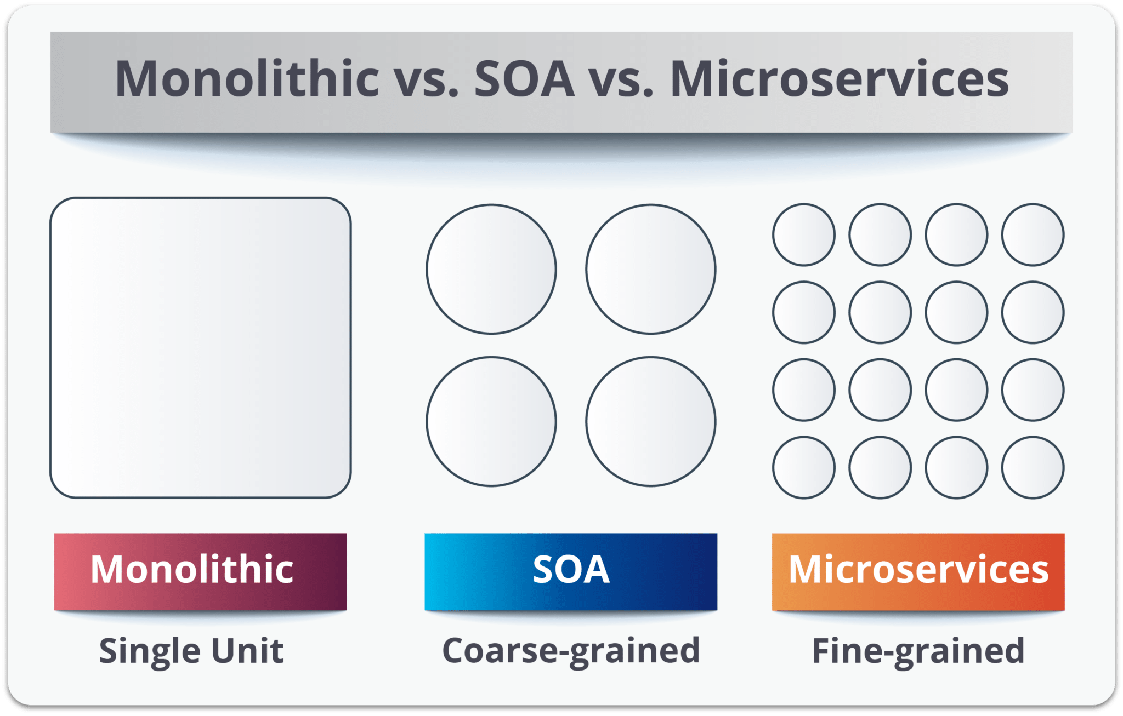

Slide 8
Monolith : It is similar to a big container wherein all the software components of an application are assembled together and tightly packaged.
Service-oriented architecture : It is essentially a collection of services. These services communicate with each other. The communication can involve either simple data passing or two or more services coordinating some activity. Some means of connecting services to each other is needed.
Microservices : It is an architectural style that structures an application as a collection of small autonomous services modeled around a business domain.

Slide 9
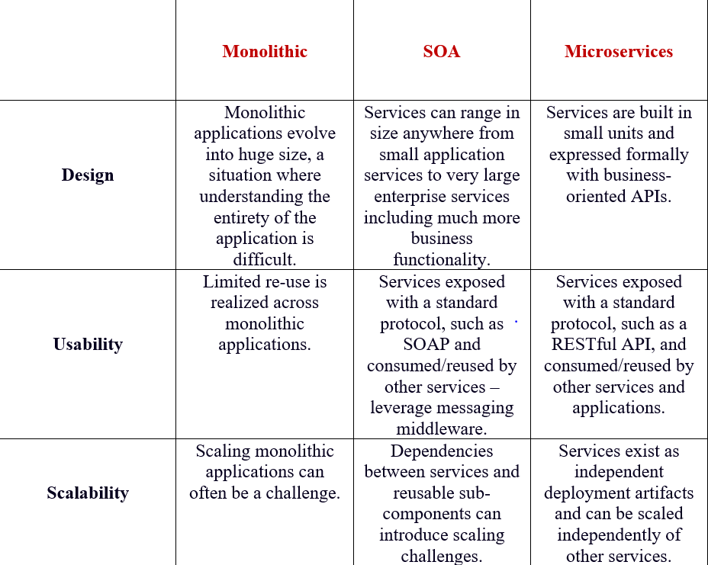

Slide 10
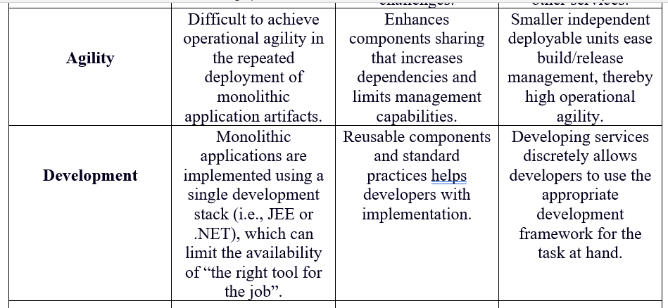

Slide 11
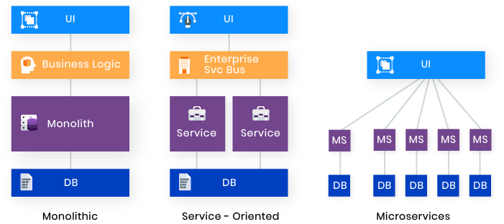
Architecture of Monolithic , Service-Oriented and Microservices
Monolithic apps consist of interdependent, indivisible units and feature very low development speed.
SOA is broken into smaller, moderately coupled services, and features slow development.
Microservices are very small, loosely coupled independent services and feature rapid continuous development.

Slide 12
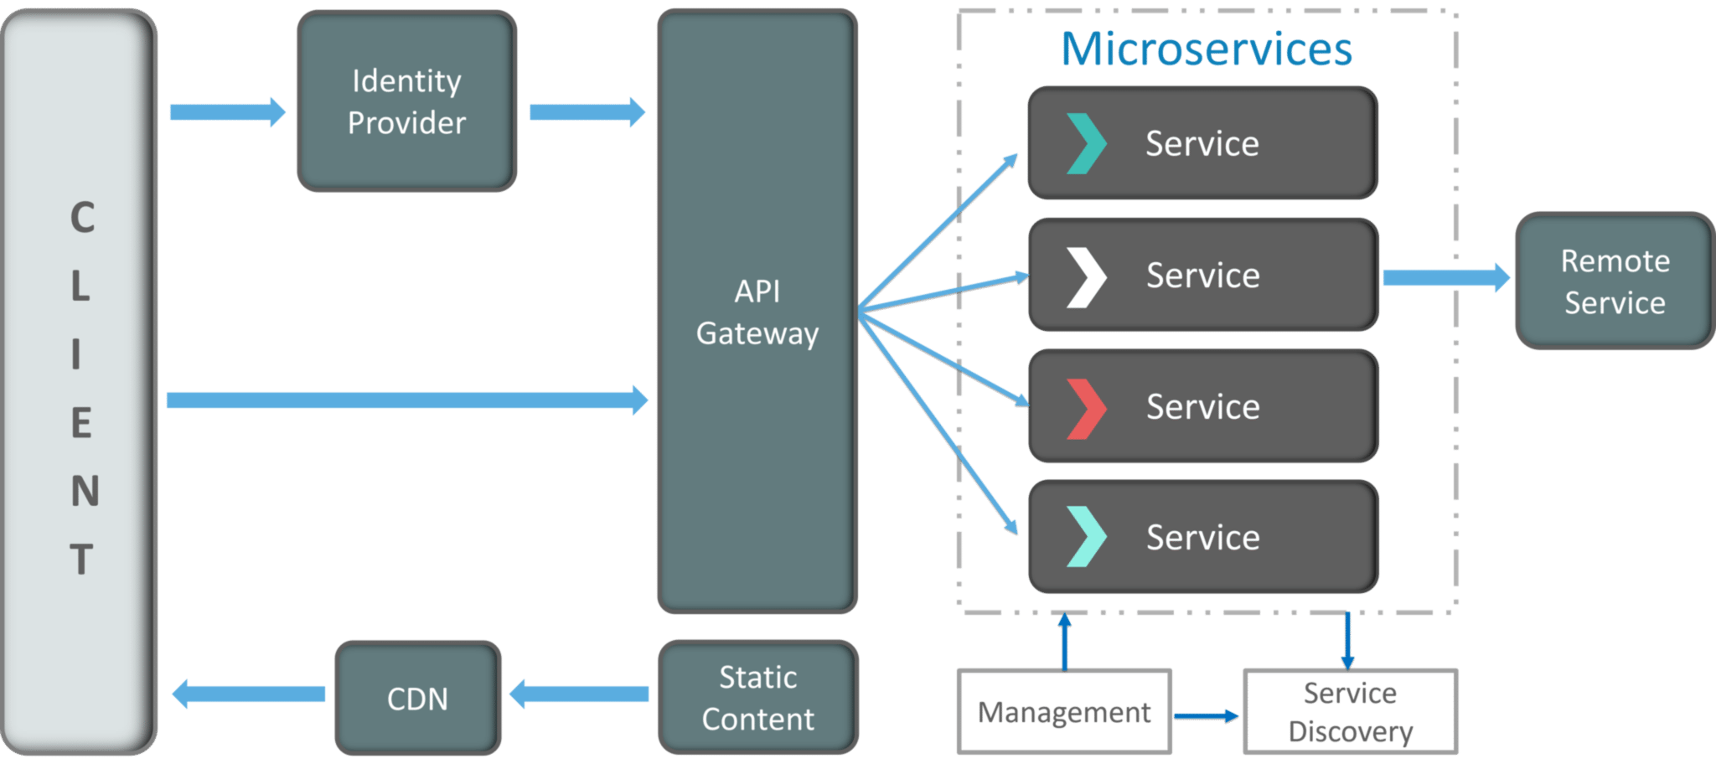
How does Microservice Architecture work

Slide 13
Clients – Different users from various devices send requests.
Identity Providers – Authenticates user or clients identities and issues security tokens.
API Gateway – Handles client requests.
Static Content – Houses all the content of the system.
Management – Balances services on nodes and identifies failures.
Service Discovery – A guide to find the route of communication between microservices.
Content Delivery Networks – Distributed network of proxy servers and their data centers.
Remote Service – Enables the remote access information that resides on a network of IT devices.
When to use Microservices:
Large applications that require a high release velocity.
Complex applications that need to be highly Scalable.
Applications with rich domains or many sub domains.
An Organization that consists of small development teams .

Slide 14
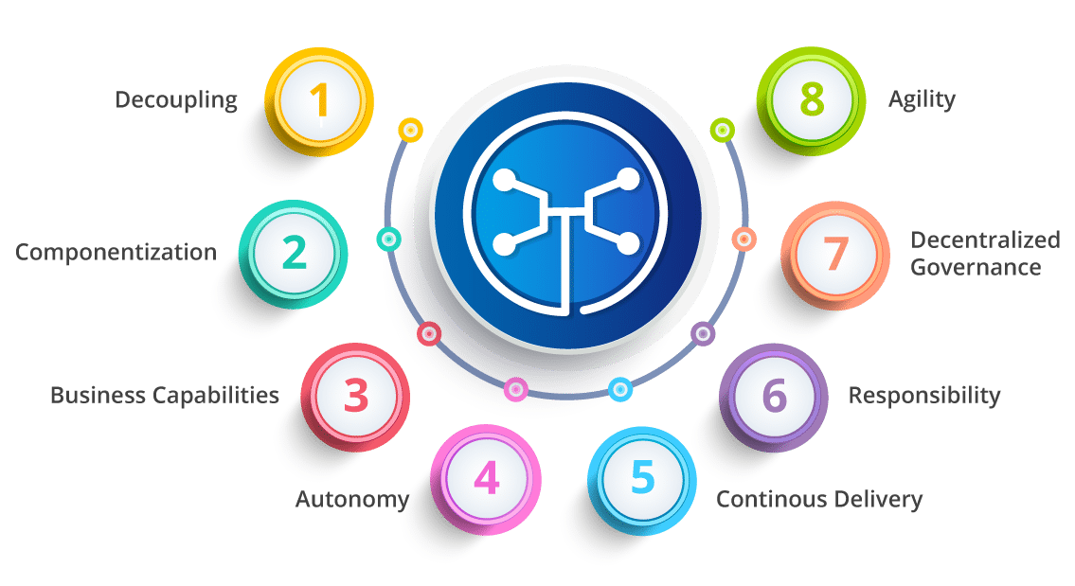
Features of Microservices

Slide 15
Decoupling – Services within a system are largely decoupled. So the application as a whole can be easily built, altered, and scaled
Componentization – Microservices are treated as independent components that can be easily replaced and upgraded
Business Capabilities – Microservices are very simple and focus on a single capability
Autonomy – Developers and teams can work independently of each other, thus increasing speed
Continuous Delivery – Allows frequent releases of software, through systematic automation of software creation, testing, and approval
Responsibility – Microservices do not focus on applications as projects. Instead, they treat applications as products for which they are responsible
Decentralized Governance – The focus is on using the right tool for the right job. That means there is no standardized pattern or any technology pattern. Developers have the freedom to choose the best useful tools to solve their problems
Agility – Microservices support agile development. Any new feature can be quickly developed and discarded again .

Slide 16
Advantages of Microservices :
Agile delivery: Decomposing the services into logically modular, independent microservices helps in Agile delivery, easily fits in the DevOps model (continuous integration, continuous deployment and continuous delivery) and faster time to market. If the application needs high deployment velocity agile delivery is the preferred option .
Diversified technologies and distributed teams: Development models support distributed teams developing the microservices in various languages. Each service can be built using the most appropriate language, tool and technology.
Asynchronous invocation: Microservices are stateless by default, helping us to asynchronously invoke them to deliver high performance and high scalability.
Headless integration model: The systems of record (SOR) such as CMS, DAM workflow and such can be integrated in headless mode through microservices so that the system of engagement will be completely decoupled from the system of record.
Token-based security: We could implement lightweight token-based security with microservices to implement authentication and fine-grained authorization for stateless microservices.
Lightweight services: The microservices provide a lightweight services model that can leverage JSON data contract.

Slide 17
Extensibility: Microservices can be leveraged to create an extensible solution by quickly onboarding newer ones.
Independent scalability: As each microservice can be independently deployed along with all the dependencies, they can also be independently scaled based on the load.
Multi-speed IT model: We can build microservices layer on top of traditional SOA-based webservices in legacy platforms to implement a multi-speed IT model.
Decoupling and loose coupling: Systems of engagement (SOE) and SOR will be fully decoupled so that we have flexibility to change the backend systems.
Cloud readiness: The microservices design can be easily integrated with Cloud environments on Cloud native containers or over Cloud-based virtual machines.
Open standards: Microservices can be built using open standards such as REST, JSON, OAuth and others.
High performance and high availability: Containerized microservices can be leveraged for high performance and availability. The asynchronous nature of microservices invocation also improves the performance.
Enabler for large and complex applications: Microservices architecture can be leveraged for developing large and complex applications that need multiple technologies and distributed teams with independent scalability

Slide 18
Resiliency and fault tolerance: Container eco-system offers features such as clustering, load balancing, circuit breaking and others to offer high resiliency and fault tolerance for the microservices. The design provides graceful degradation of functionality.
Independent development and deployment: Each microservice can be independently developed and deployed by different teams. This helps us to incrementally add features and functionalities.
Responsive to changes: We can easily change the existing features and extend the functionality with microservices architecture.
Independent Development :All microservices can be easily developed based on their individual functionality.
Independent Deployment :Based on their services, they can be individually deployed in any application.
Fault Isolation : Even if one service of the application does not work, the system still continues to function.
Mixed Technology Stack:Different languages and technologies can be used to build different services of the same application.
Granular Scaling:Individual components can scale as per need, there is no need to scale all components together

Slide 19
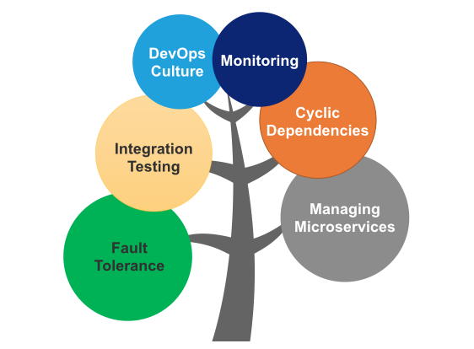
Challenges of Microservices Architecture
Monitoring: The traditional way of monitoring will not align well with microservices because we have multiple services making up the same functionality previously supported by a single application.
Fault Tolerance: Fault tolerance is the individual service that does not bring down the overall system. The application can operate at a certain degree of satisfaction when the failure occurs. Without fault tolerance, a single failure in the system may cause a total breakdown.
Integration testing : It is the phase in software testing in which individual software modules are combined and tested as a group.
DevOps Culture: Microservices fits perfectly into the DevOps. It provides faster delivery service, visibility across data, and cost-effective data.
Managing Microservices : No microservices are made in a vacuum. In this Refcard , we explore the benefits and requirements of developing microservices, the role of DevOps in the microservices development process, and techniques for managing microservices.
Cyclic Dependency: Dependency management across different services, and its functionality is very important. The cyclic dependency can create a problem, if not identified and resolved promptly.

Slide 20
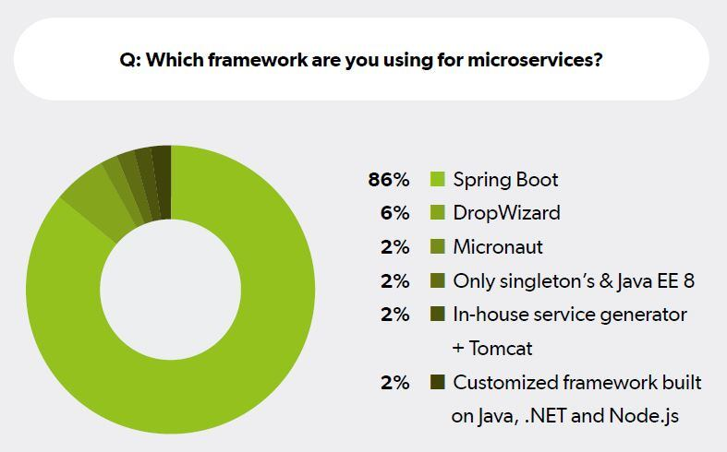

Slide 21
There are several microservices frameworks that you can use for developing for Java. Some of these are:
Spring Boot – This is probably the best Java microservices framework that works on top of languages for Inversion of Control, Aspect Oriented Programming, and others.
Drop wizard – Drop wizard pulls together stable, mature libraries from the Java ecosystem into a simple, light-weight package that lets you focus on getting things done.
Restlet – Restlet Framework helps Java developers build better web APIs that follow the REST architecture style.
Spark – A micro-framework for creating web applications in Kotlin and Java 8 with minimal effort.

Slide 22
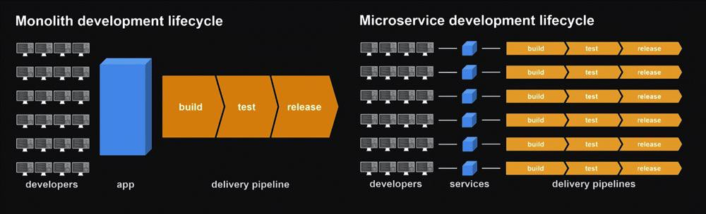

Slide 23


